Slide 1
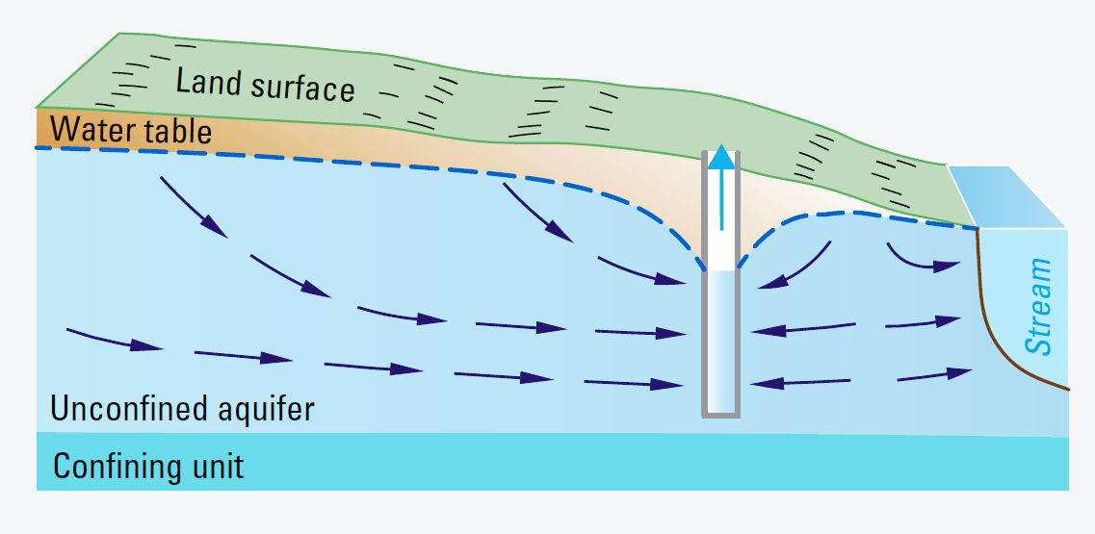
GroMore Project
Model Ensembles
Group 1 - Amanda, Justin, Tesfa, Vivek

Slide 2
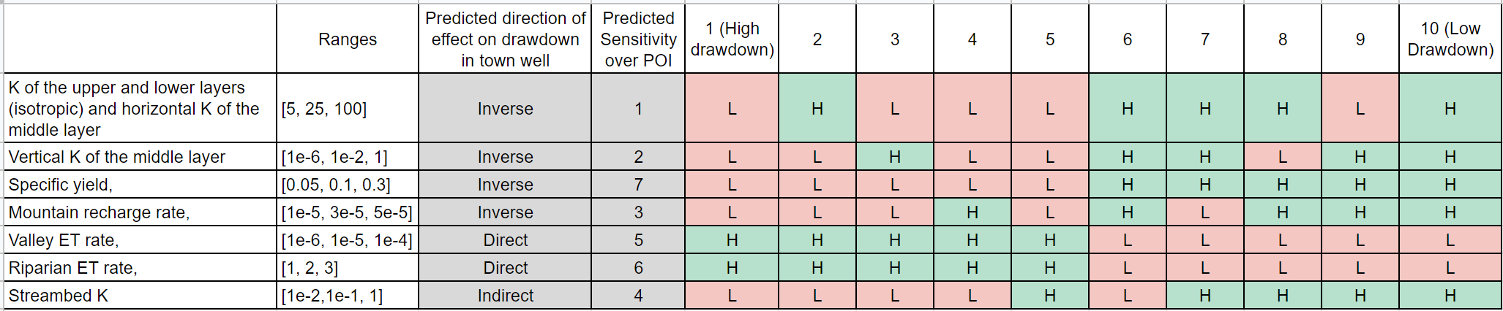
Drawdown Prediction
Strategy:
Whether Direct or inverse relation to drawdown. Highest and Lowest predicted on this basis
Predicted Parameter Sensitivity
Toggle the high sensitivity parameters to get ‘most different models’
The arbitrarily chosen ranges would also affect drawdown

Slide 3
Drawdown Results
Ranking of 10 models (low drawdown first) | 10 | 9 | 8 | 7 | 6 | 5 | 4 | 3 | 2 | 1
Avg head @ town well | 55.44 | 69.03 | - | 56.79 | 55.59 | 65.75 | 65.5 | 68.59 | 60.03 | 65.57
Actual Rank | 10 | 1 | - | 7 | 8 | 3 | 5 | 2 | 6 | 4
Rank difference | 0 | 8 | - | 0 | -2 | 2 | -1 | 1 | -4 | -3
Analysis
Having low K in the upper and lower layers in combination with high VKA in the middle layer broke our model, but less often when there was high streambed K
The most important parameter is the K of the upper and lower layers, but the conjunction of this with the vertical K of the middle layer is very important
We get the most drawdown when they are at the low-low settings, and the least drawdown when they are at the high-low settings, medium drawdown with high-high (55.44m is the lowest and 69.03m is the highest)
Other parameters have minimal impacts, including streambed K which was surprising

Slide 4
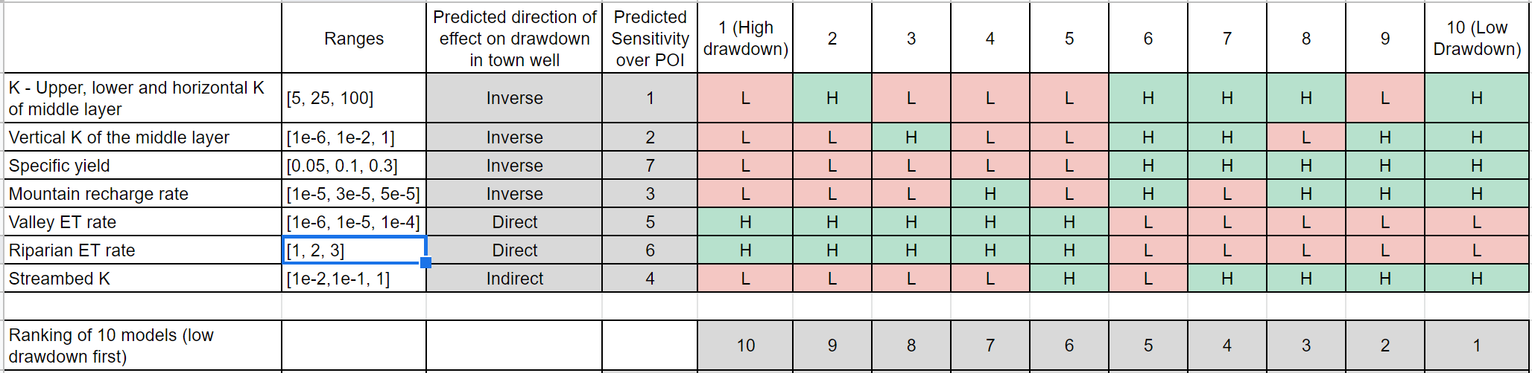
Analysis
Ranking of 10 models (low drawdown first) | 10 | 9 | 8 | 7 | 6 | 5 | 4 | 3 | 2 | 1
Avg head @ town well | 55.44 | 69.03 | - | 56.79 | 55.59 | 65.75 | 65.5 | 68.59 | 60.03 | 65.57
Actual Rank | 10 | 1 | - | 7 | 8 | 3 | 5 | 2 | 6 | 4
Rank difference | 0 | 8 | - | 0 | -2 | 2 | -1 | 1 | -4 | -3

Slide 5
No Convergence | Ranges | Ens_3 | Ens_9
K of the upper and lower layers (isotropic) and horizontal K of the middle layer | [5, 25, 100] | L | L
Vertical K of the middle layer | [1e-6, 1e-2, 1] | H | H
Specific yield, | [0.05, 0.1, 0.3] | L | H
Mountain recharge rate, | [1e-5, 3e-5, 5e-5] | L | H
Valley ET rate, | [1e-6, 1e-5, 1e-4] | H | L
Riparian ET rate, | [1, 2, 3] | H | L
Streambed K | [1e-2,1e-1, 1] | L | H
Notes:
I think we predicted those first two rows as the most sensitive vars and id guess this combo of those two leads to failed convergence? Thoughts?
Agreed, I mentioned briefly on slide 3 but will expand more when discussing!

Slide 6
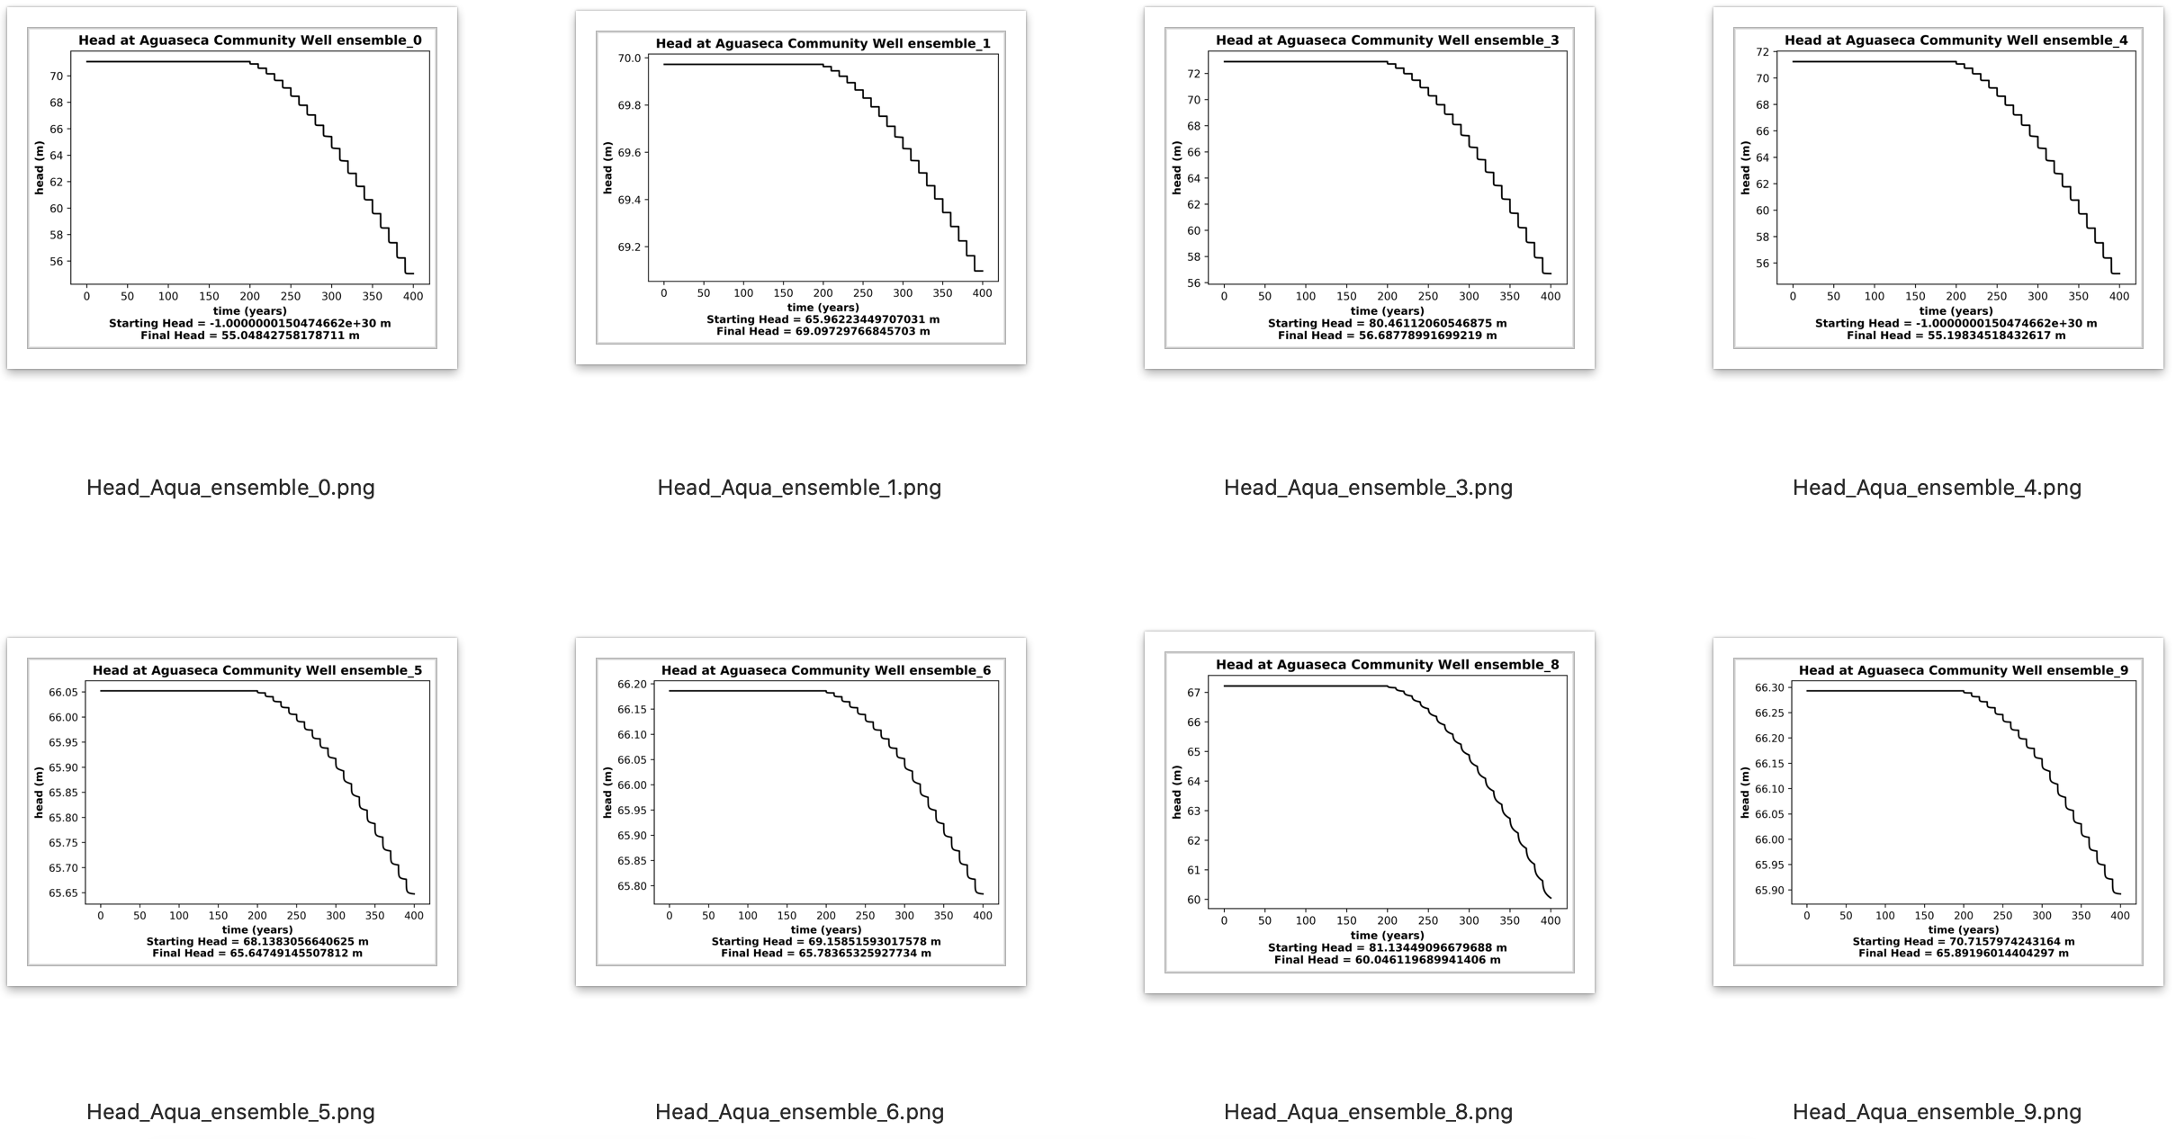
Head Plots over Time @ Aguaseca Community Well

Slide 7
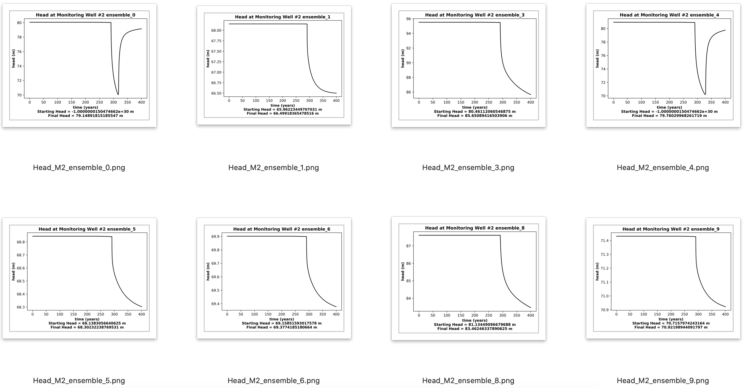
Head Plots over Time @ MW#2

Slide 8
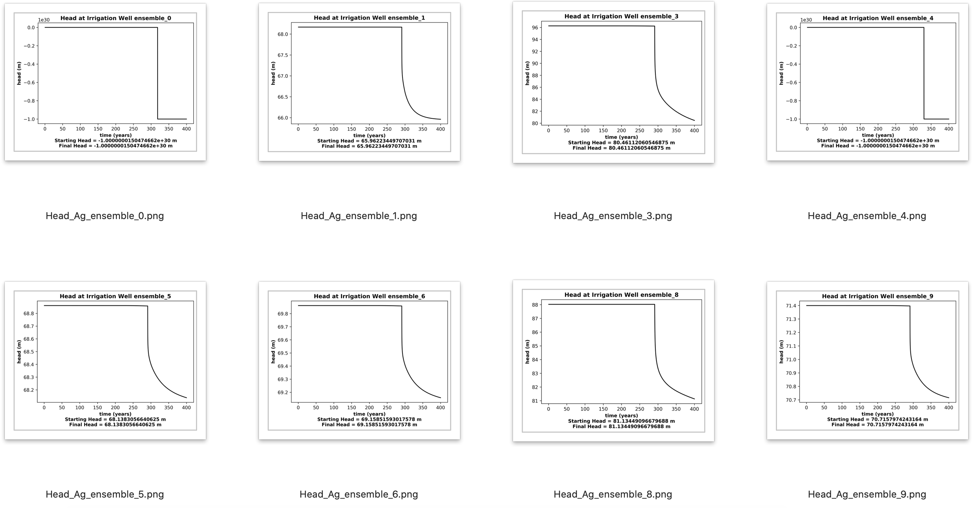
Head Plots over Time @ Irrigation Well

Slide 9
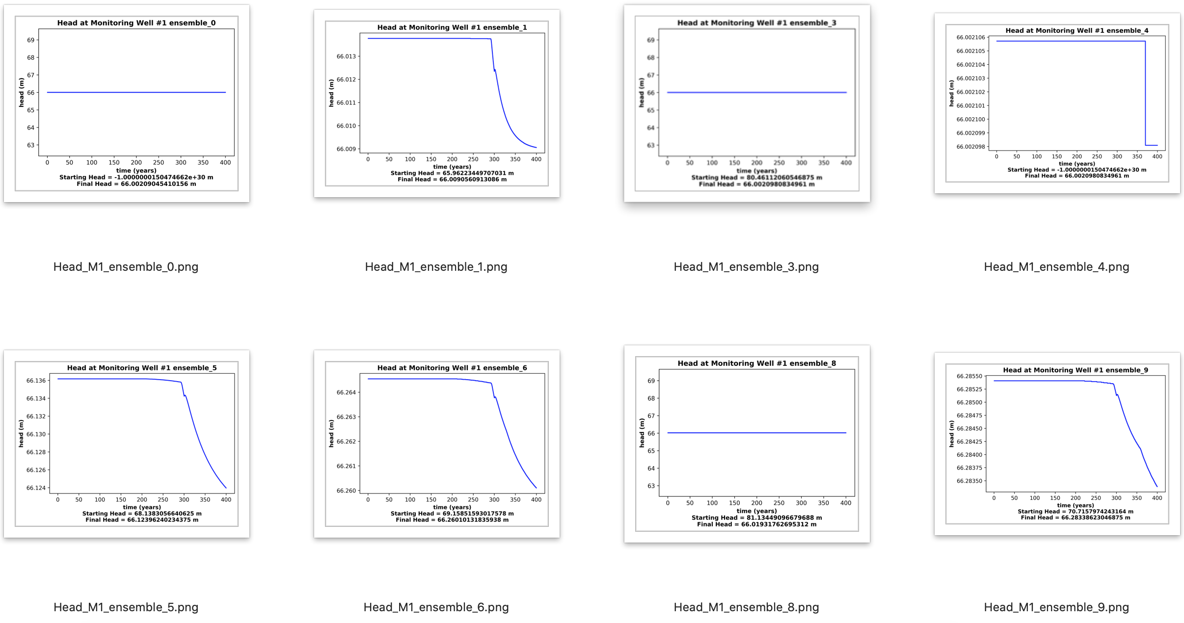
Head Plots over Time @ MW#1

Slide 10
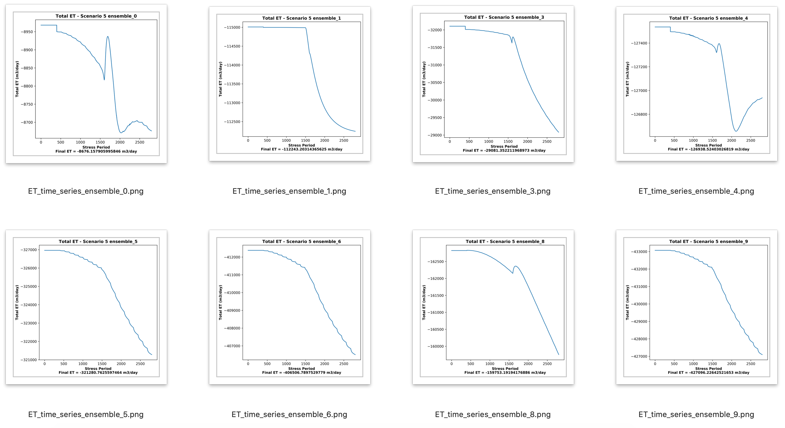
ET over Time

Slide 11
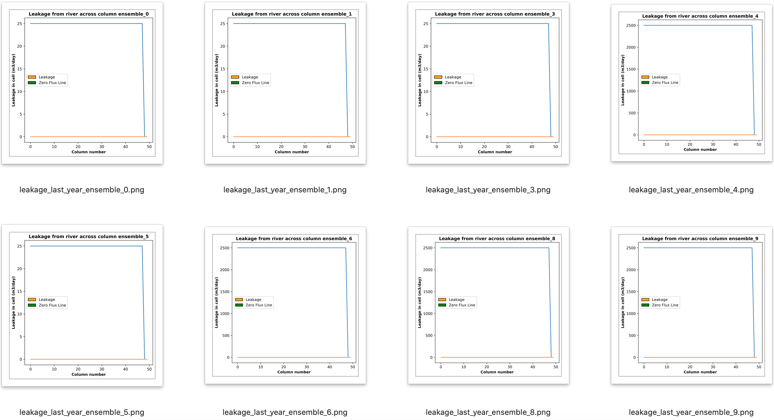
Failed Leakage Plots over Time

